Slide 1

TEAM DECEPTICONS
Andrea Arnold Anant Natekar
Rajeesh Gopi Hasan Nazir
Siji Mohan Eric Tocco
Arun Pattanayak (Microsoft)

Slide 2

BUSINESS PROBLEM
NM Clients are surrendering
BILLIONS
of dollars in permanent life insurance cash value every year.

Slide 3
6345637007

Slide 4

63 45 63 70 07

Slide 5

634-563-7007

Slide 6

$6,345,637,007.00
Cash value that left the company 2015-2017

Slide 7
TRENDING
⬆8.50%
⬆9.58%
⬆15.06%
⬆3.18%
Notes:
Retention is so important because sales have flatlined, but surrenders are skyrocketing

Slide 8









IRAs
Life
LTC
529s
DI
Investments
Advisory
Annuities

Slide 9

BUSINESS VALUE
Build a solution to predict which policies will leave the company so we can get ahead of it and mitigate further loss.
  Had the company saved just 10% of this business, we could have retained
  $600 Million in cash value.

Slide 10
We used AI to
predict
and get in front of future
policy surrenders

Slide 11
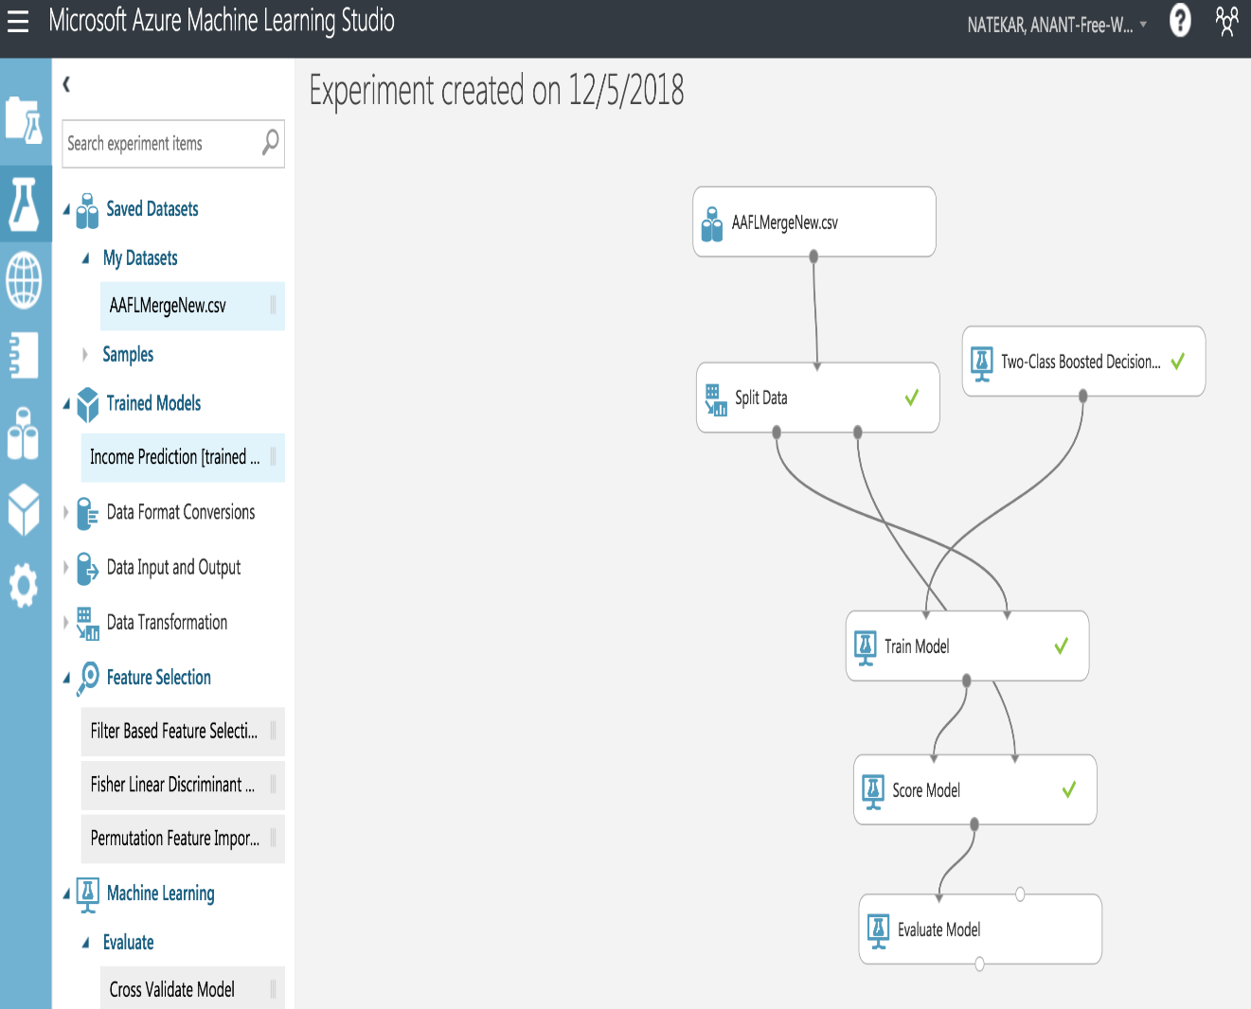
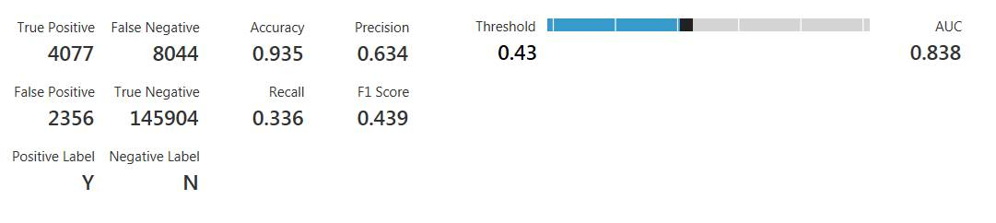
SOLUTION
Stack used
    Microsoft Azure Machine learning studio
    Two class boosted decision tree Algorithm
    Power BI & Excel
Data Used
    Majority Mock Data
    Worked with EIRC to get other policy data
Machine Learning data

Slide 12
NEXT STEPS
Reduce Noise
Common Reasons for Surrender
Policy Information
    Rating
    Riders
    Length of time in underwriting
Financial rep info
    FR years of service
      <2 years of service
      >30 years of service
No need for death benefit
    Age of policyowner
    Age of beneficiary
    Policy date
    Other products owned by client
      IRA
      529
Notes:
Outstanding debt

Slide 13
NEXT STEPS
More Complex Algorithm
Info on policyholder
    Region
    State
    Zip code
    Occupation
    Net worth
    Call center contacts
      # of calls
      Who called
      Why did they call
Info on policyholder, cont.
    Call center contacts
    Financial stress
    Age of insured
    Age of beneficiary
    Marital status
    Annual income
    Length of policy/contract
    CRC client
Rep info
    Length of service
    Complaints
    Financial hardship
    Writing agent vs. servicing agent
Premium
Frequency of payment
Notes:
Outstanding debt

Slide 14
NEXT STEPS
  The MVP can be ready within a week. Pulling information for all products and then using different algorithms and testing it out will take a couple of months
  Getting data from different areas will be important. Also help from Microsoft experts on algorithms to be used would be required

Slide 15
